Slide 1
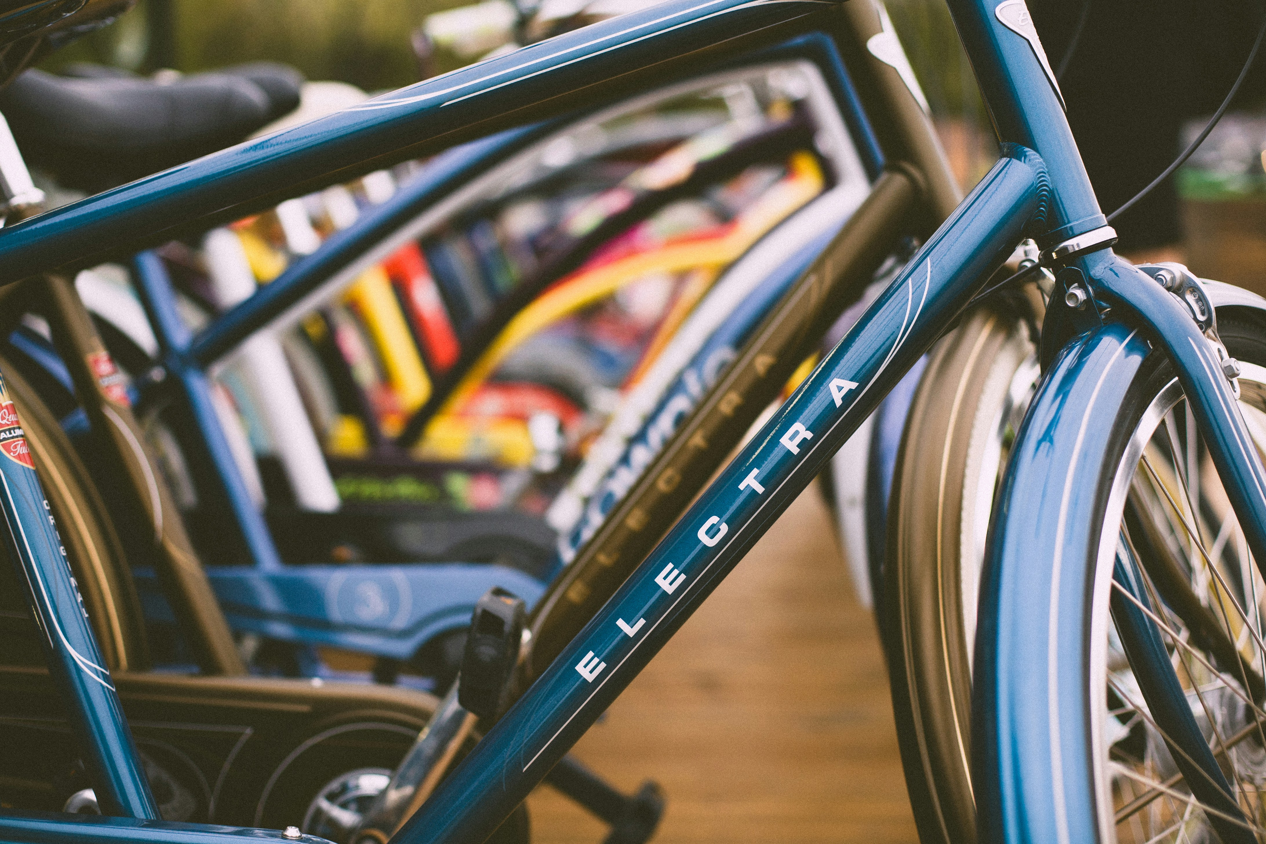


28.05.24 Wheely Good Rentals
dmTECH
Customer Messaging

Slide 2

The Task
Tell us what you did
2

Slide 3

Demo
Show us the results
3

Slide 4
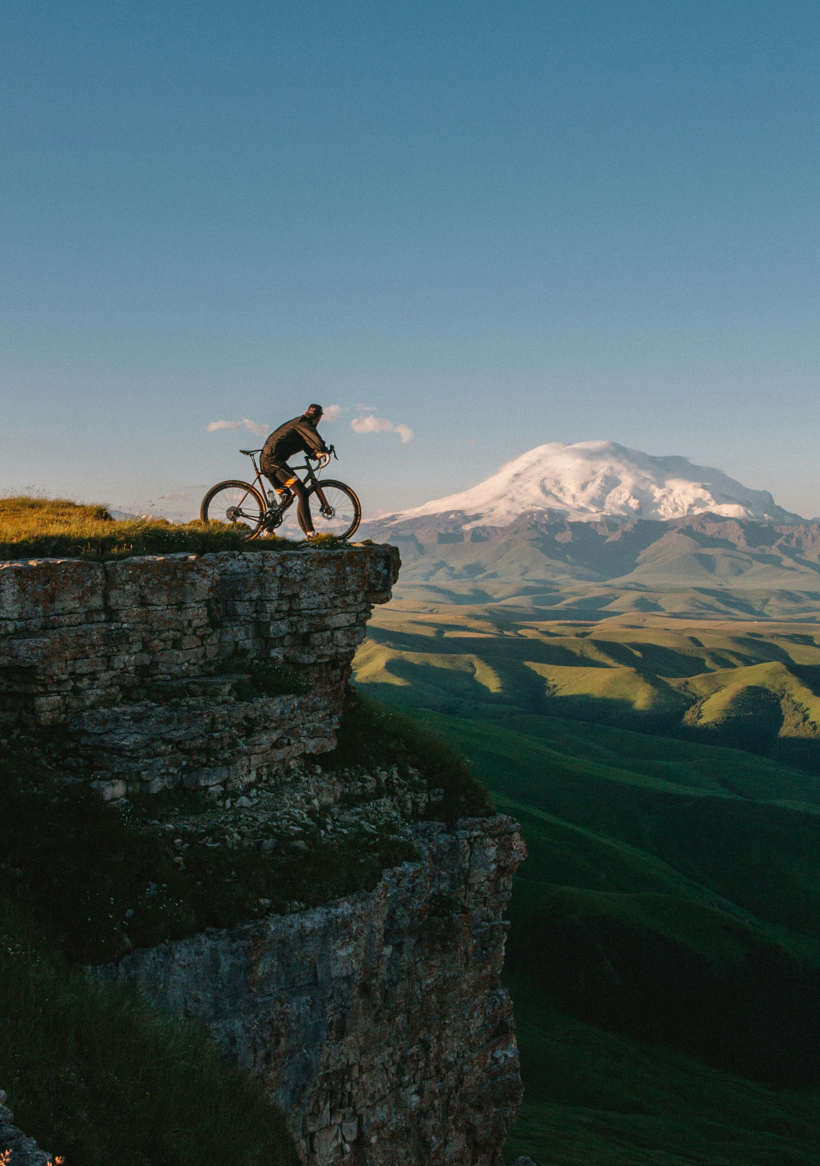
Highlights
What was your favorite part of the task?
4

Slide 5
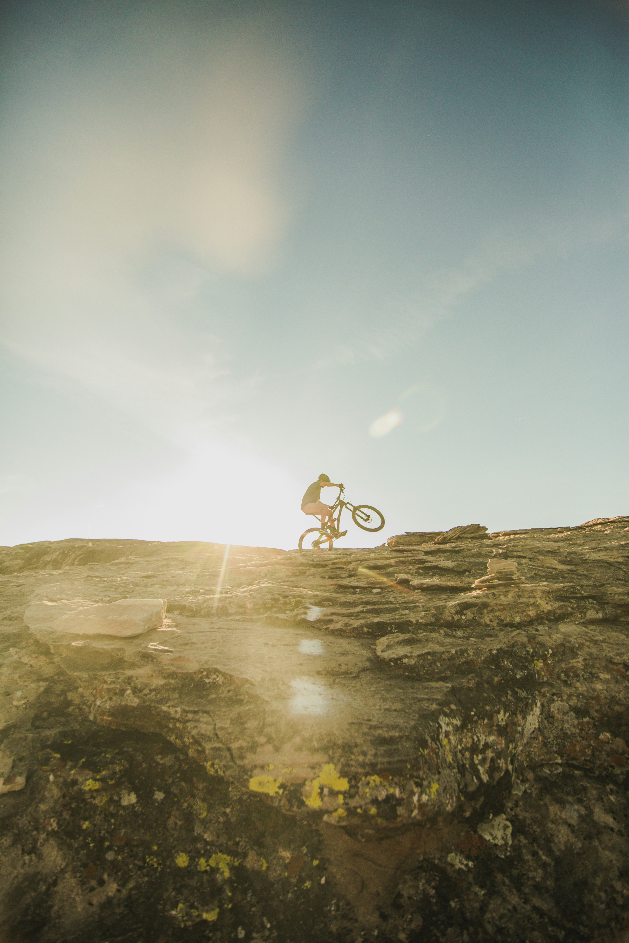
Challenges
What challenges did you face?
5

Slide 6
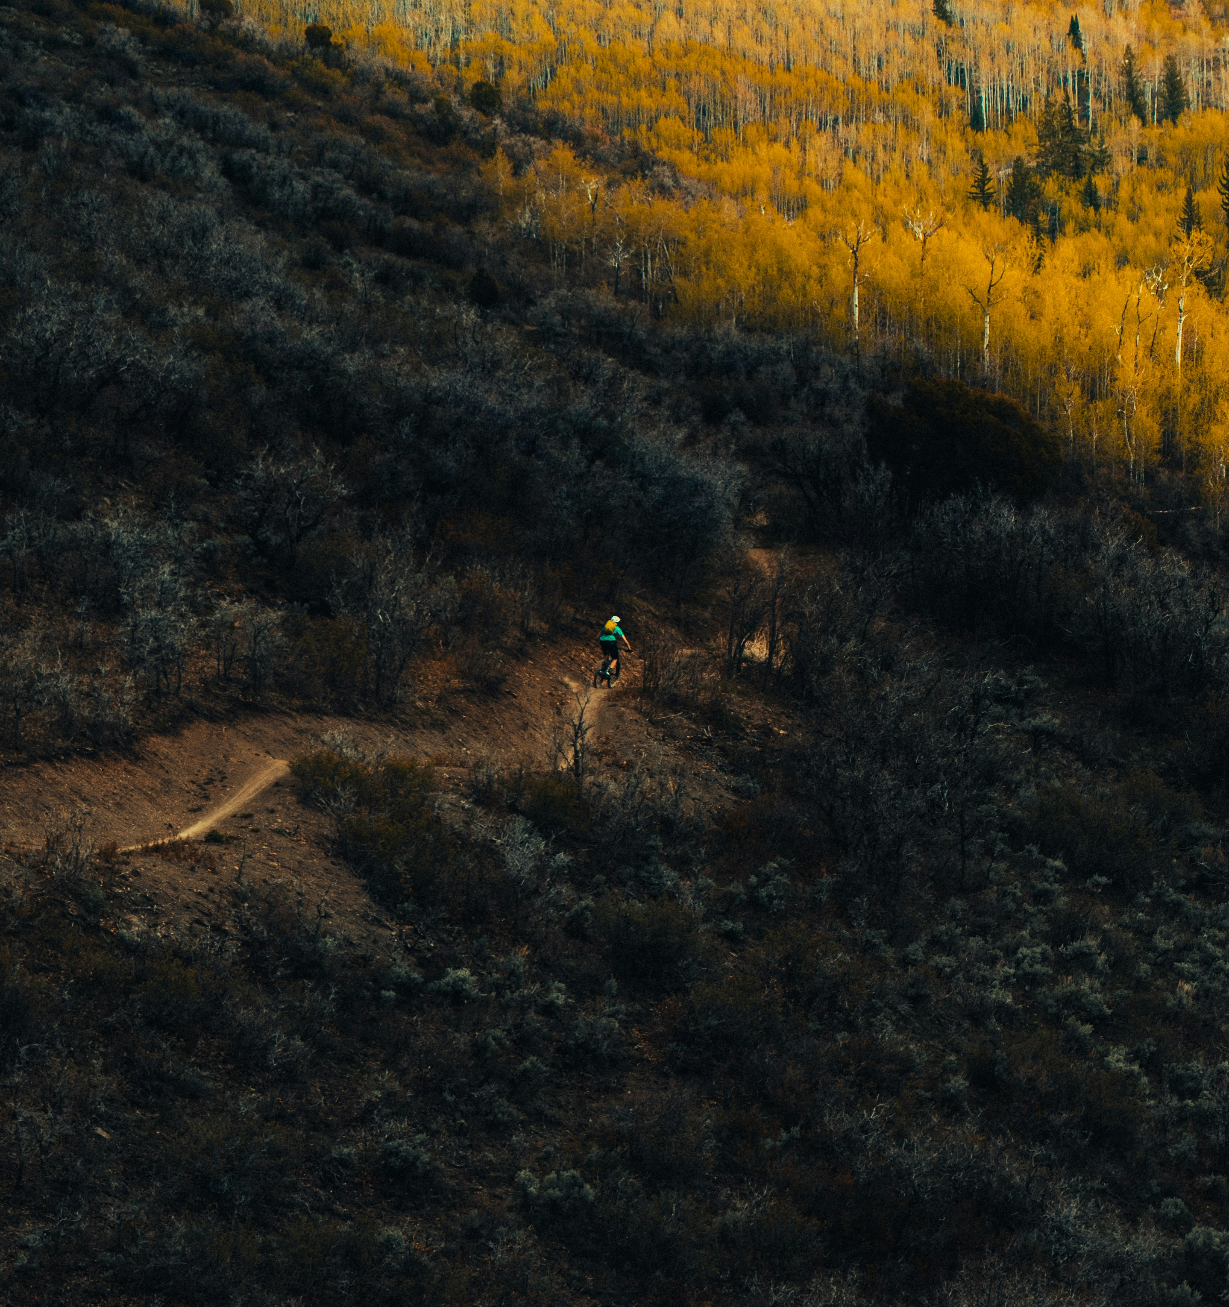
Next Steps
If you could continue, what else would you like to do?
6

Slide 7
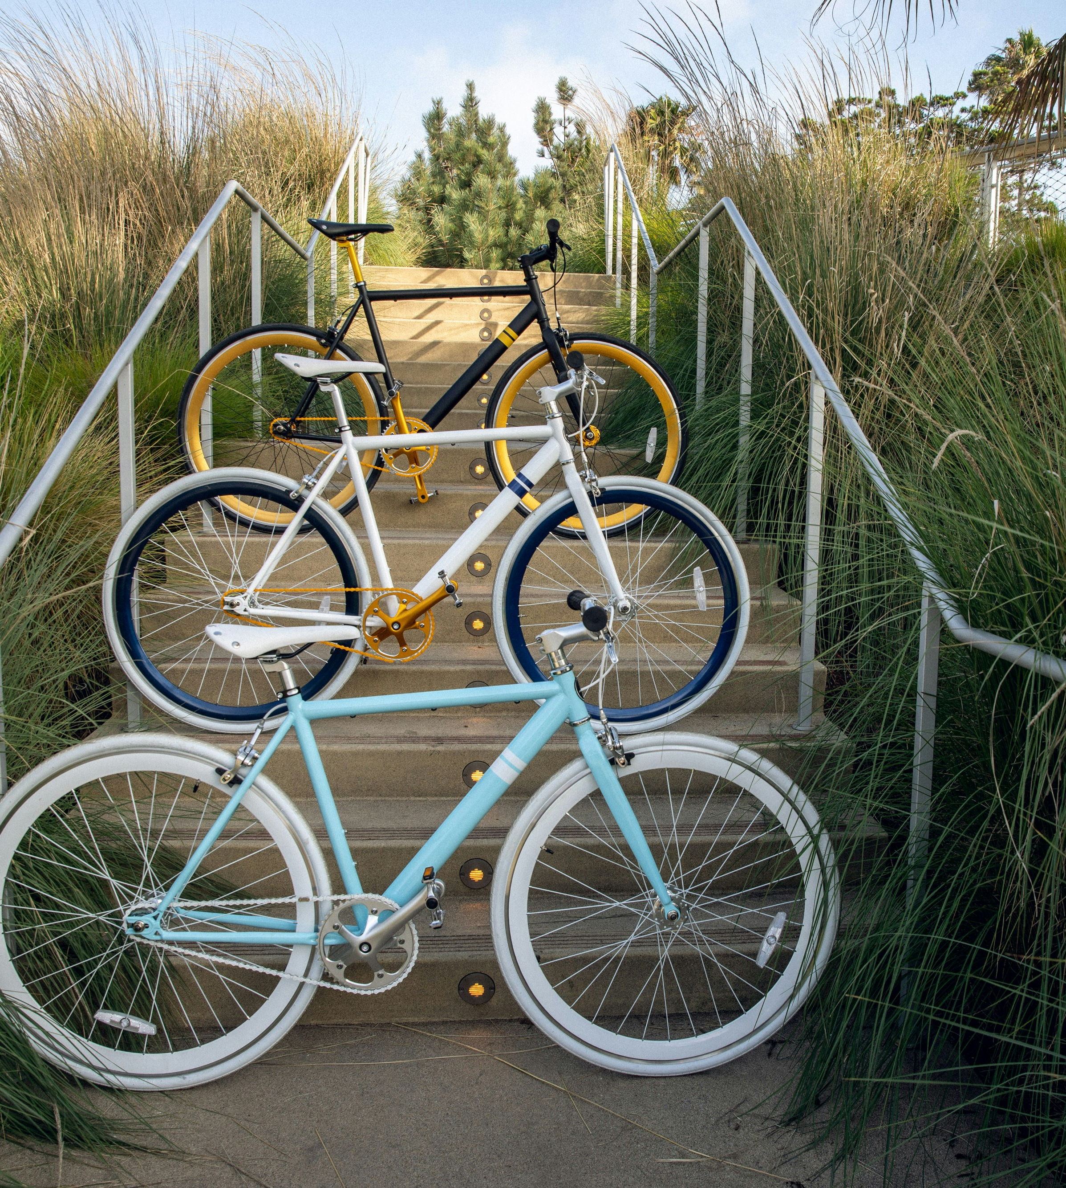
Conclusion
What are your conclusions?
7

Slide 8
Thank you

